Slide 1
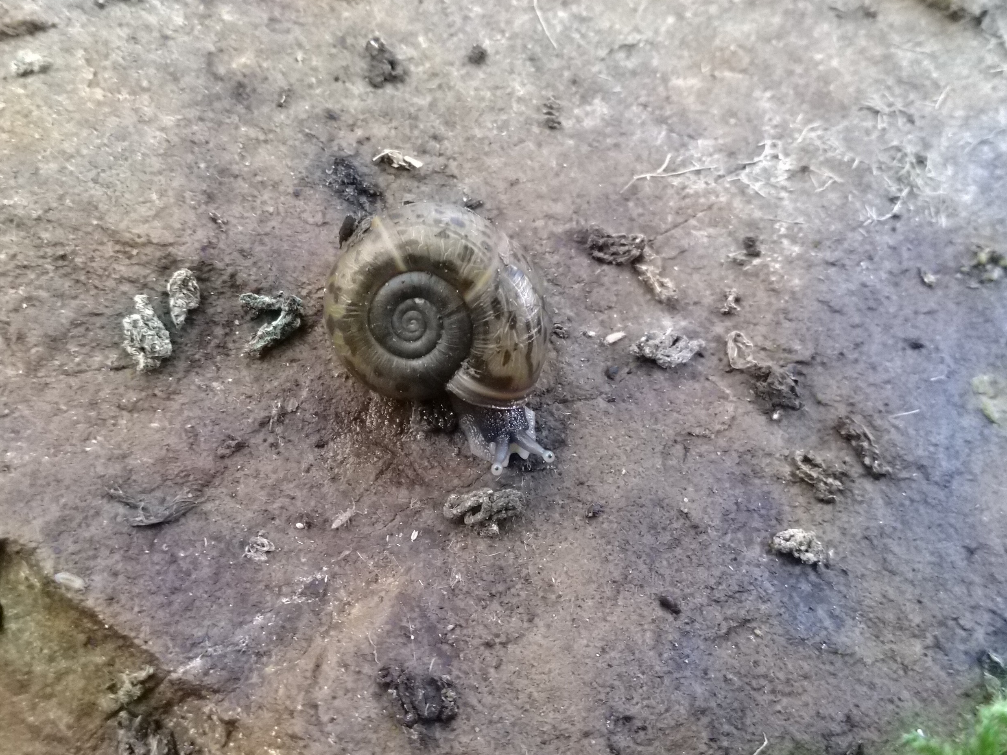
Applied biodiversity informatics on land snail data from Spain
Ward Langeraert
Promotor: Dimitri Brosens (INBO)
Elona quimperiana
(Blainville, 1821)

Slide 2
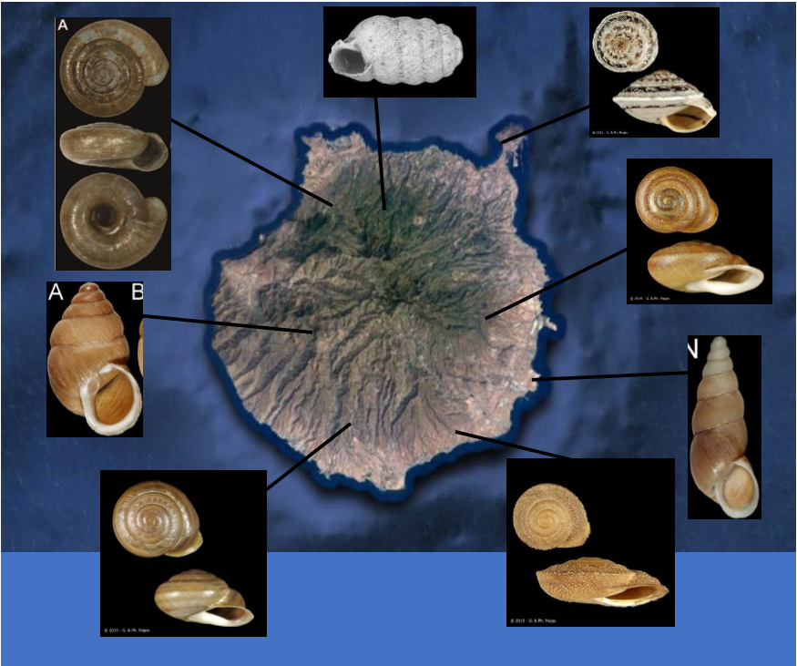
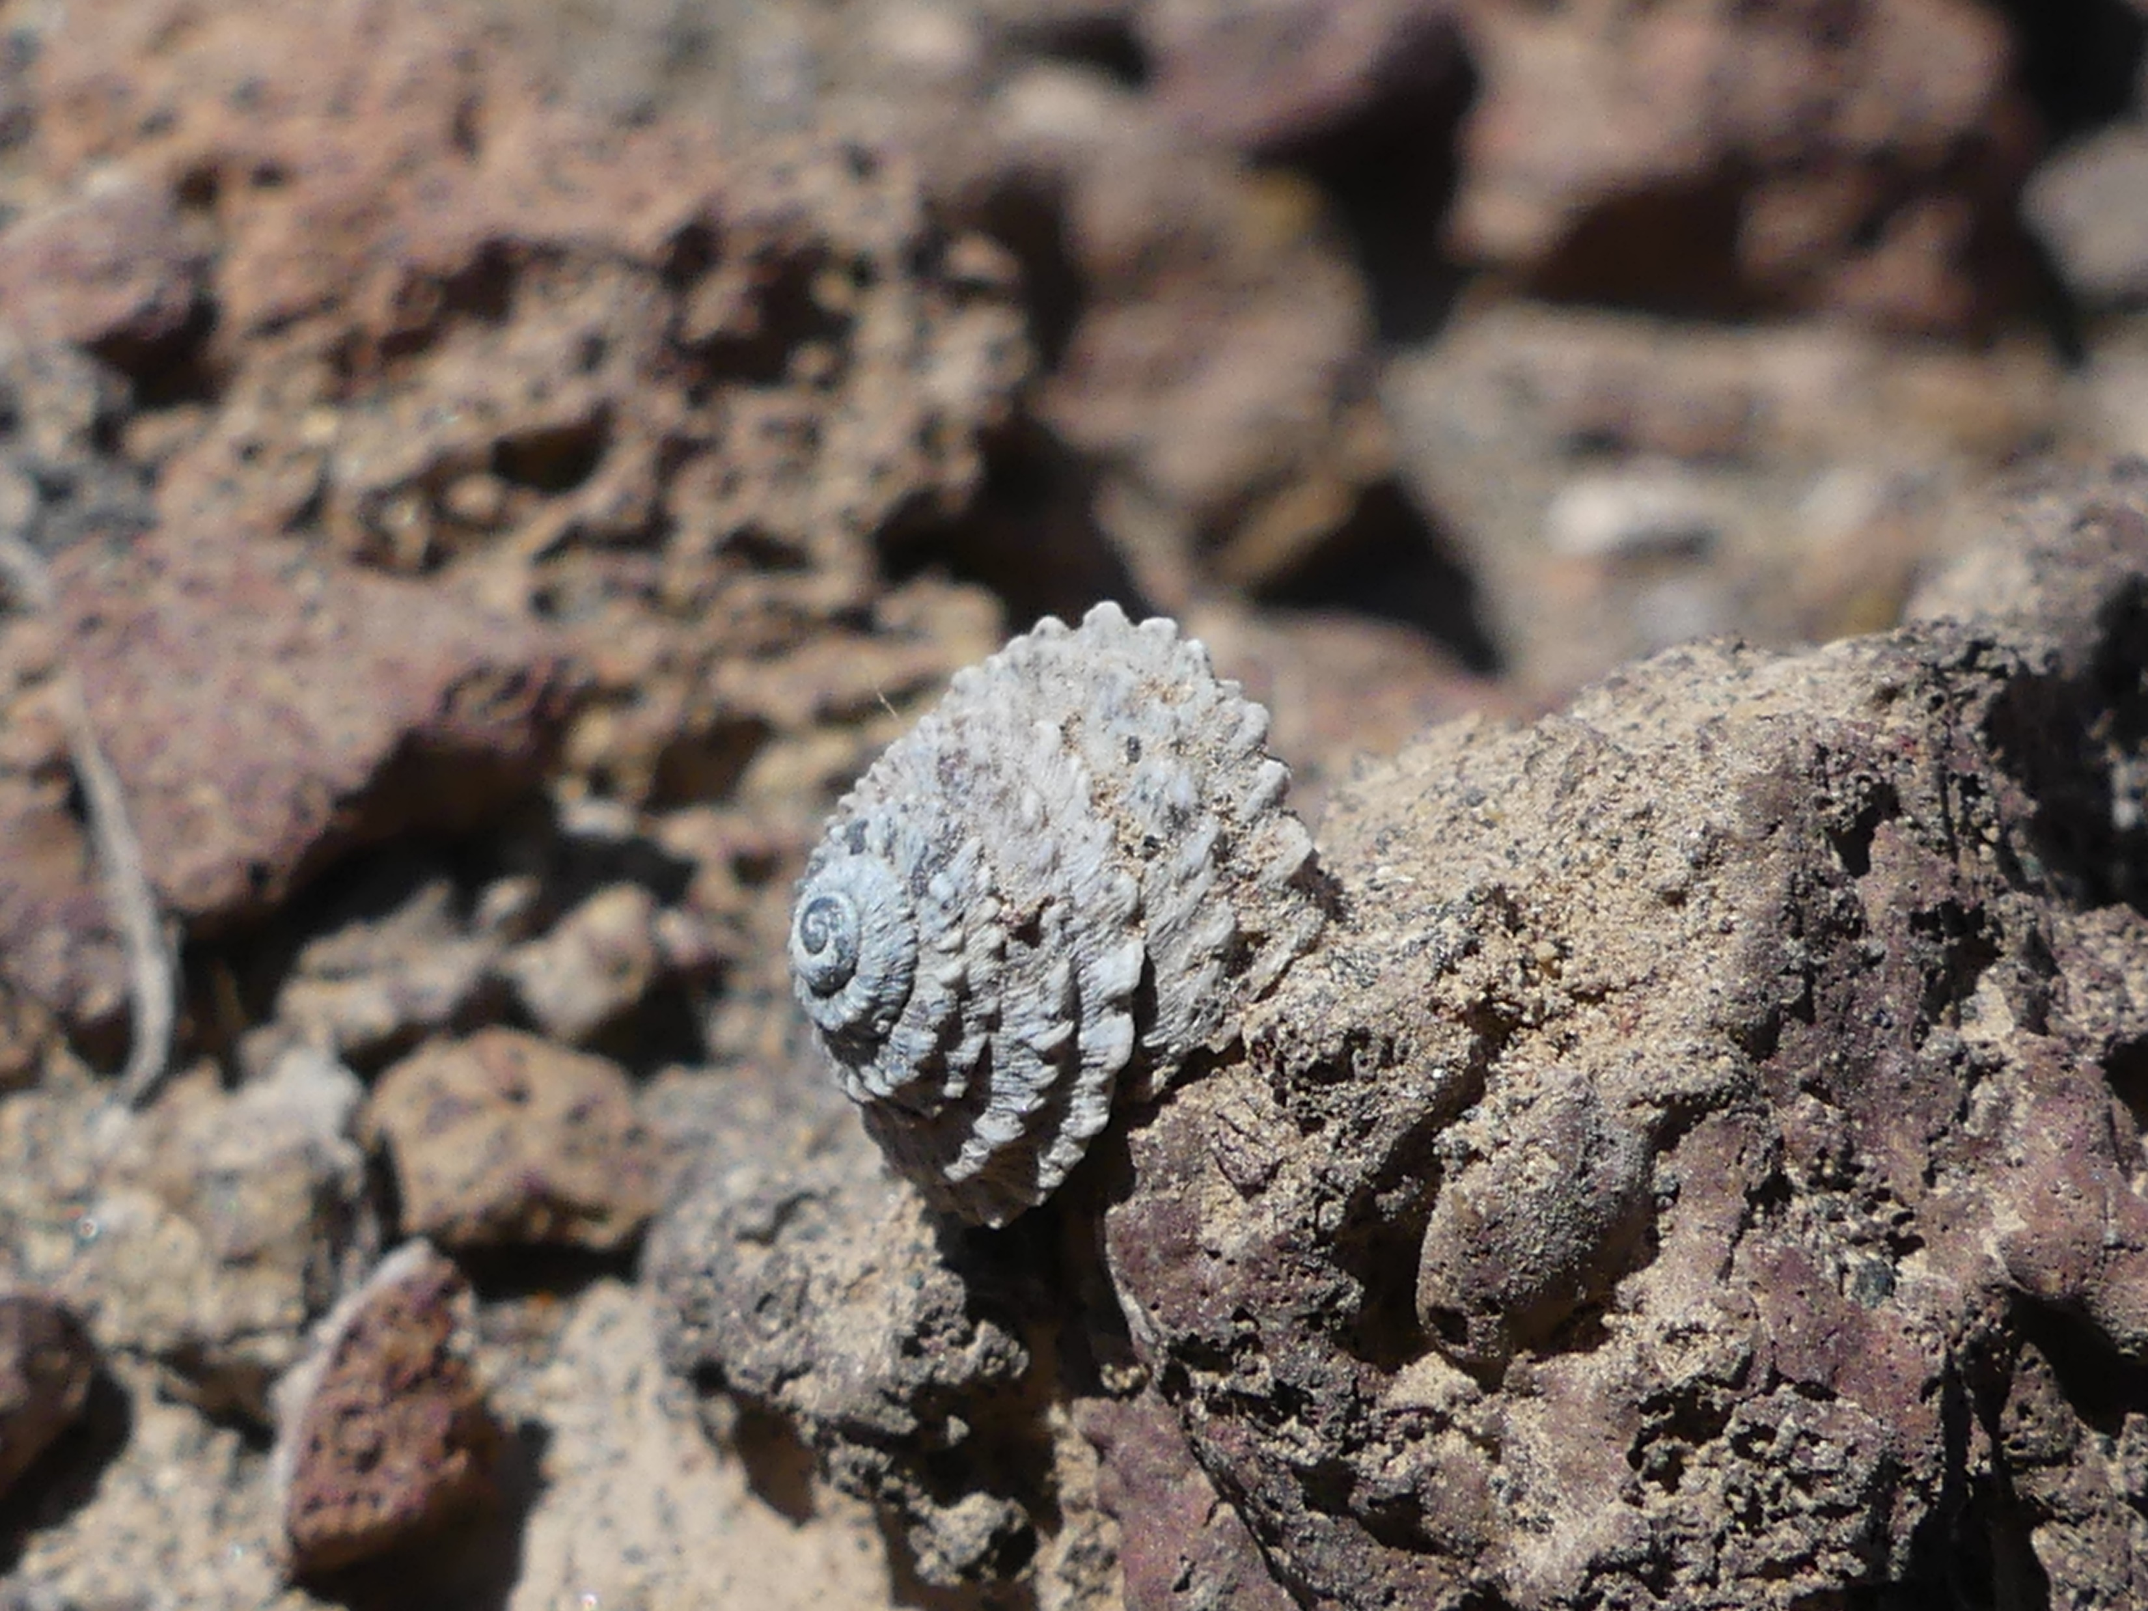
Intro
Shell collecting: an ancient hobby
Collectors >>> malacologist researchers
Result: a lot of knowledge in private collections not open to the public/researchers
Especially the case for underinvestigated areas like the Canary Islands
Important repercussions for conservation!
Main goal:
Publish data online to increase knowledge on species
Emphasis on endemics
Obelus despreauxii (D'Orbigny, 1839)

Slide 3
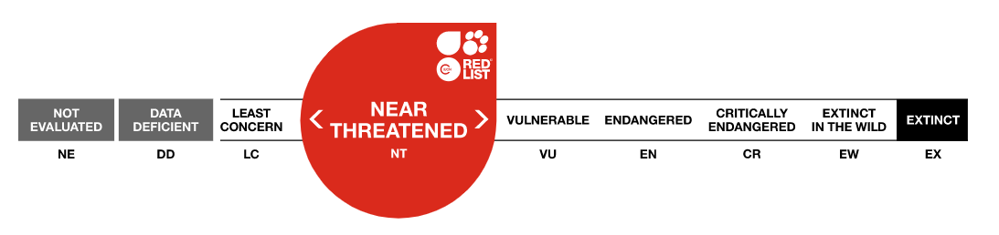
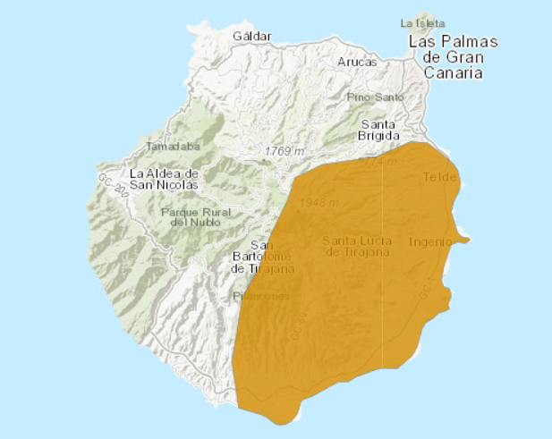
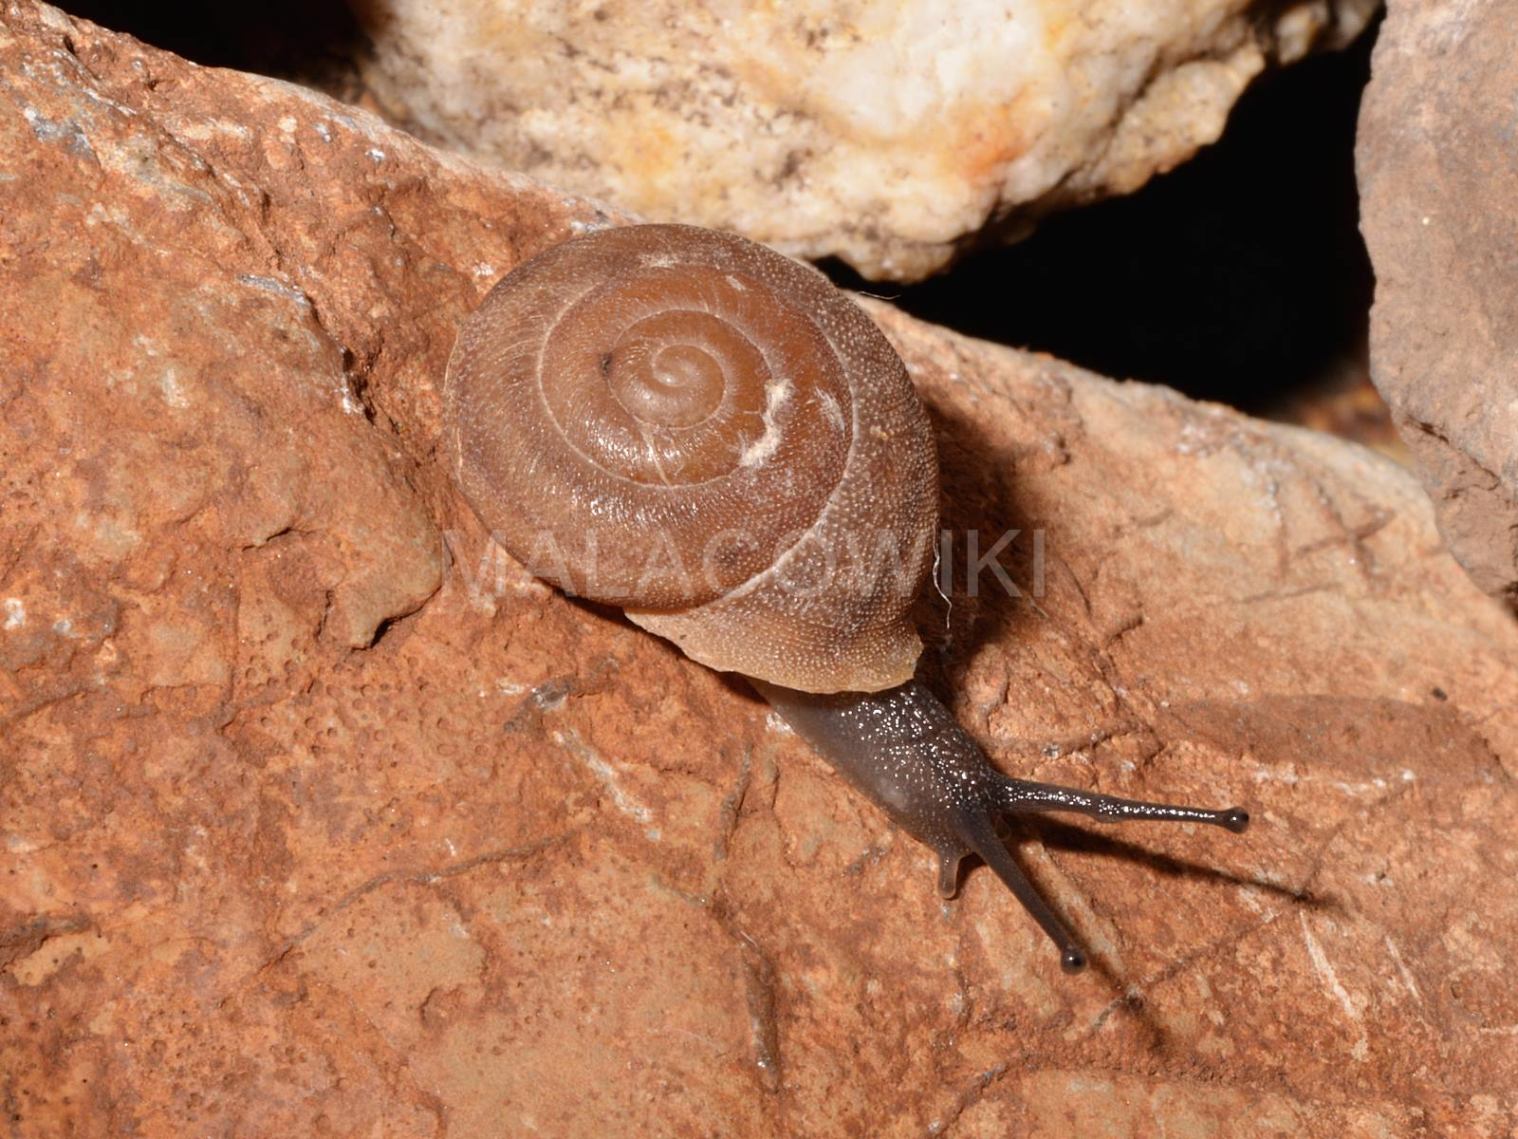
Research Q
Hemicycla saponacea (Lowe, 1861)
Publish land and freshwater mollusc data on GBIF
Gran Canaria (+250 records)
Northern Spain (+100 records)
New species
Species ranges
Learn to work with biodiversity data
Using R
Using online repositories
Publish data paper
Scientific description of the data set
Niche modelling/Red list assessment
https://www.iucnredlist.org/species/156686/4983241

Slide 4
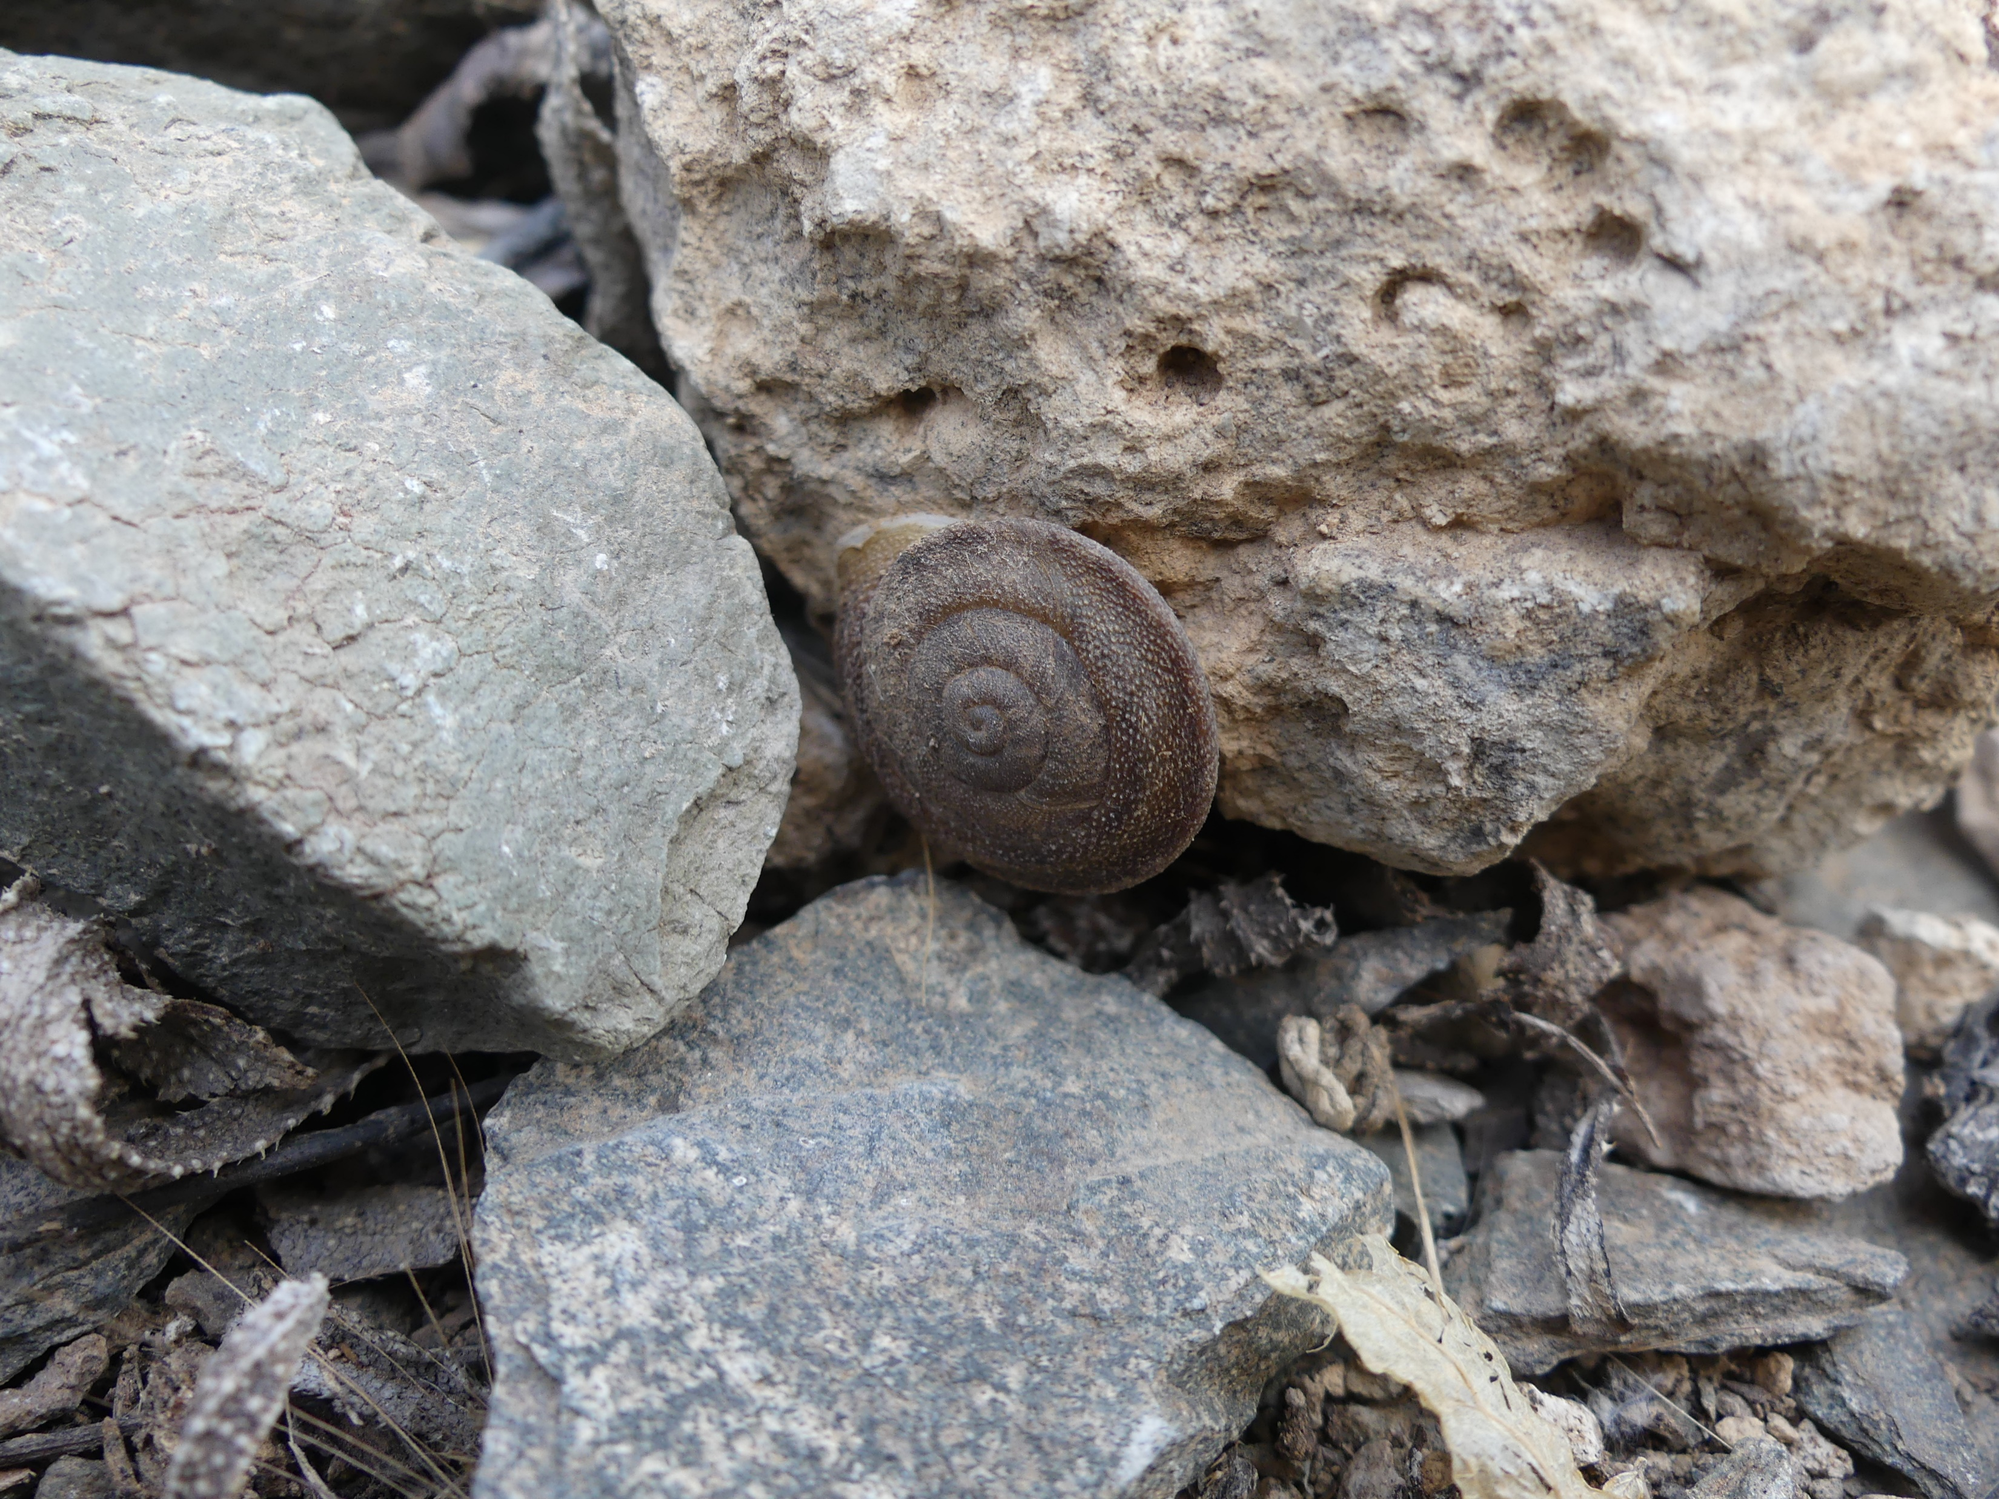
Work plan
8 weeks
Week 1-2 (7 afternoons 4 hours)
Make up RAW dataset
Digitalized and from collection
Week 3-4 (7 afternoons 4 hours)
Data manipulation in RStudio
GitHub repository
Week 5-6 (7 afternoons 4 hours)
Create data paper
Via GBIF integrated publishing toolkit (IPT)
Metadata and scientific description of the data set
Week 7-8 (7 afternoons 4 hours)
Niche modelling (Wallace Ecological Modelling App)
Endemic species
Hemicycla berkeleii (Lowe, 1861)

